Slide 1
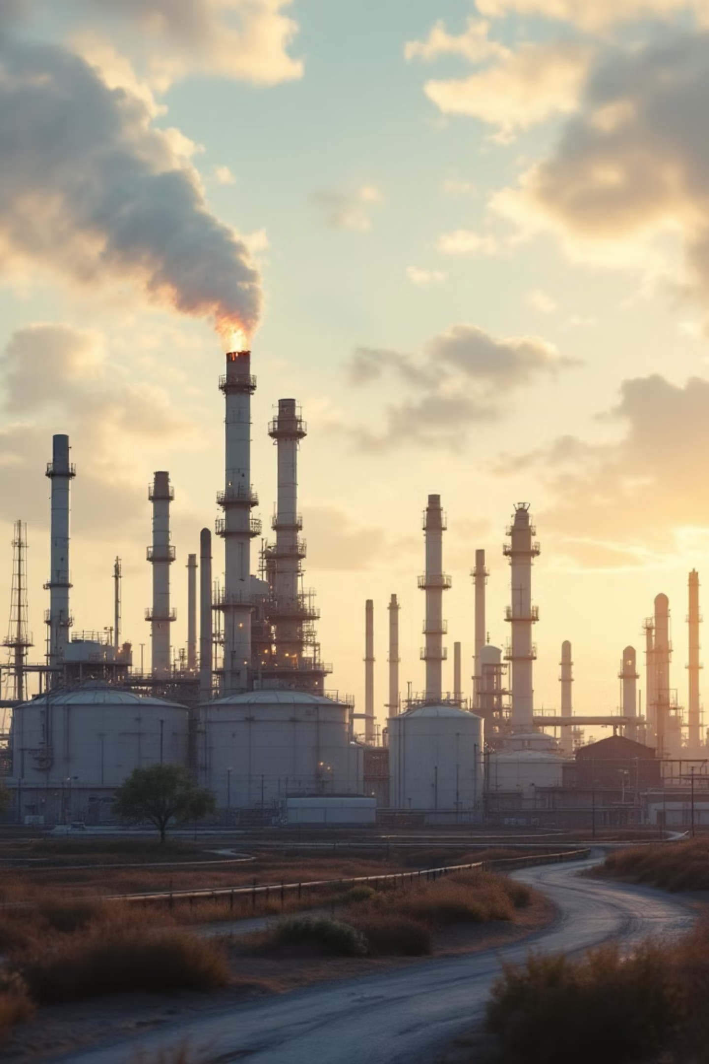


Flare Gas Estimation and Environmental Impact Assessment
A comprehensive analysis of flare gas data to assess environmental impacts, energy recovery potential, and health exposure.
Presented by:
Amira Hassan Abelsalam
Esraa Gamal Awed
Nehad Hesham Fathy
Shahinaz Bashir Abdallah

Slide 2
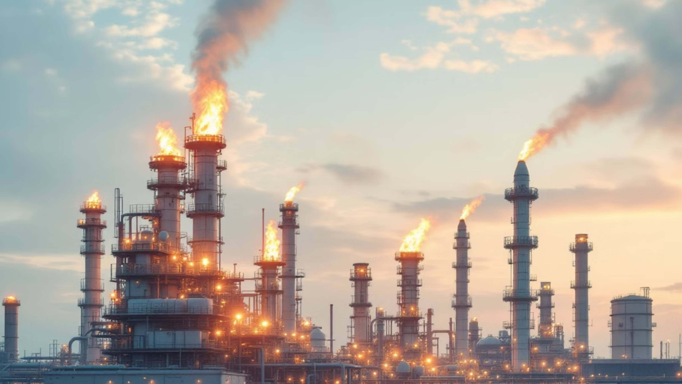



Introduction to Flare Gas Analysis
Gas flaring, the practice of burning off natural gas associated with crude oil extraction, is a significant environmental concern in petroleum production. This project addresses the critical need to monitor and analyse flare gas to mitigate its adverse effects.
Background of Gas Flaring
Importance of Monitoring
Project Objectives
Flaring is a routine practice in oil and gas operations, disposing of associated gas that is uneconomical to capture or transport.
Monitoring is crucial for understanding emission scale, identifying reduction opportunities, and ensuring regulatory compliance.
Our aim is to provide actionable insights on environmental impacts, energy recovery, and health risks from gas flaring.

Slide 3


Comprehensive Data Overview
Our analysis leverages extensive datasets spanning over a decade, providing a robust foundation for assessing gas flaring trends and impacts.
Key Data Points
Timeframe: 2012–2024
Flare Volume: Amount of gas flared (cubic metres)
Oil Production: Crude oil output (barrels)
Air Pollutants: PM (Particulate Matter), NO₂ (Nitrogen Dioxide), CO₂ (Carbon Dioxide), CO₂eq (Carbon Dioxide equivalent)
Health Metrics: Indicators of population health exposure

Slide 4






Data Cleaning and Preprocessing in Power BI
Rigorous data cleaning and preprocessing were essential to ensure the accuracy and reliability of our analysis, executed efficiently using Power BI.
Initial Data Import
Raw data from various sources imported into Power BI for initial review.
Duplicate Removal
Identified and eliminated redundant entries to maintain data integrity.
Missing Value Imputation
Addressed gaps in data through appropriate imputation techniques to ensure comprehensive analysis.
Data Transformation
Standardised formats and units across all variables for consistent analysis.
These steps were critical in preparing a clean, reliable dataset that underpins all subsequent findings and recommendations.

Slide 5







Key Analysis Questions & Findings
Our analysis reveals critical insights into gas flaring, its environmental footprint, energy waste, and impact on human health.
Trends & Patterns
Energy Opportunity
Significant global and regional flaring trends identified.
Recoverable energy potential from flared gas quantified, revealing economic loss.
Environmental Impact
Health Exposure
Direct correlation between flaring and air pollutants (PM, NO₂, CO₂) established.
Communities disproportionately affected by flaring emissions identified.
Comparative Insights
Scenario Analysis
Countries ranked by flare intensity and emissions for policy benchmarks.
Improvements in emissions and health forecasted under various reduction scenarios.

Slide 6


Dashboard Visualisation: Key Insights from Power BI

Slide 7

Dashboard Visualisation: Key Insights from Power BI

Slide 8
Dashboard Visualisation: Key Insights from Power BI

Slide 9
Dashboard Visualisation: Key Insights from Power BI

Slide 10
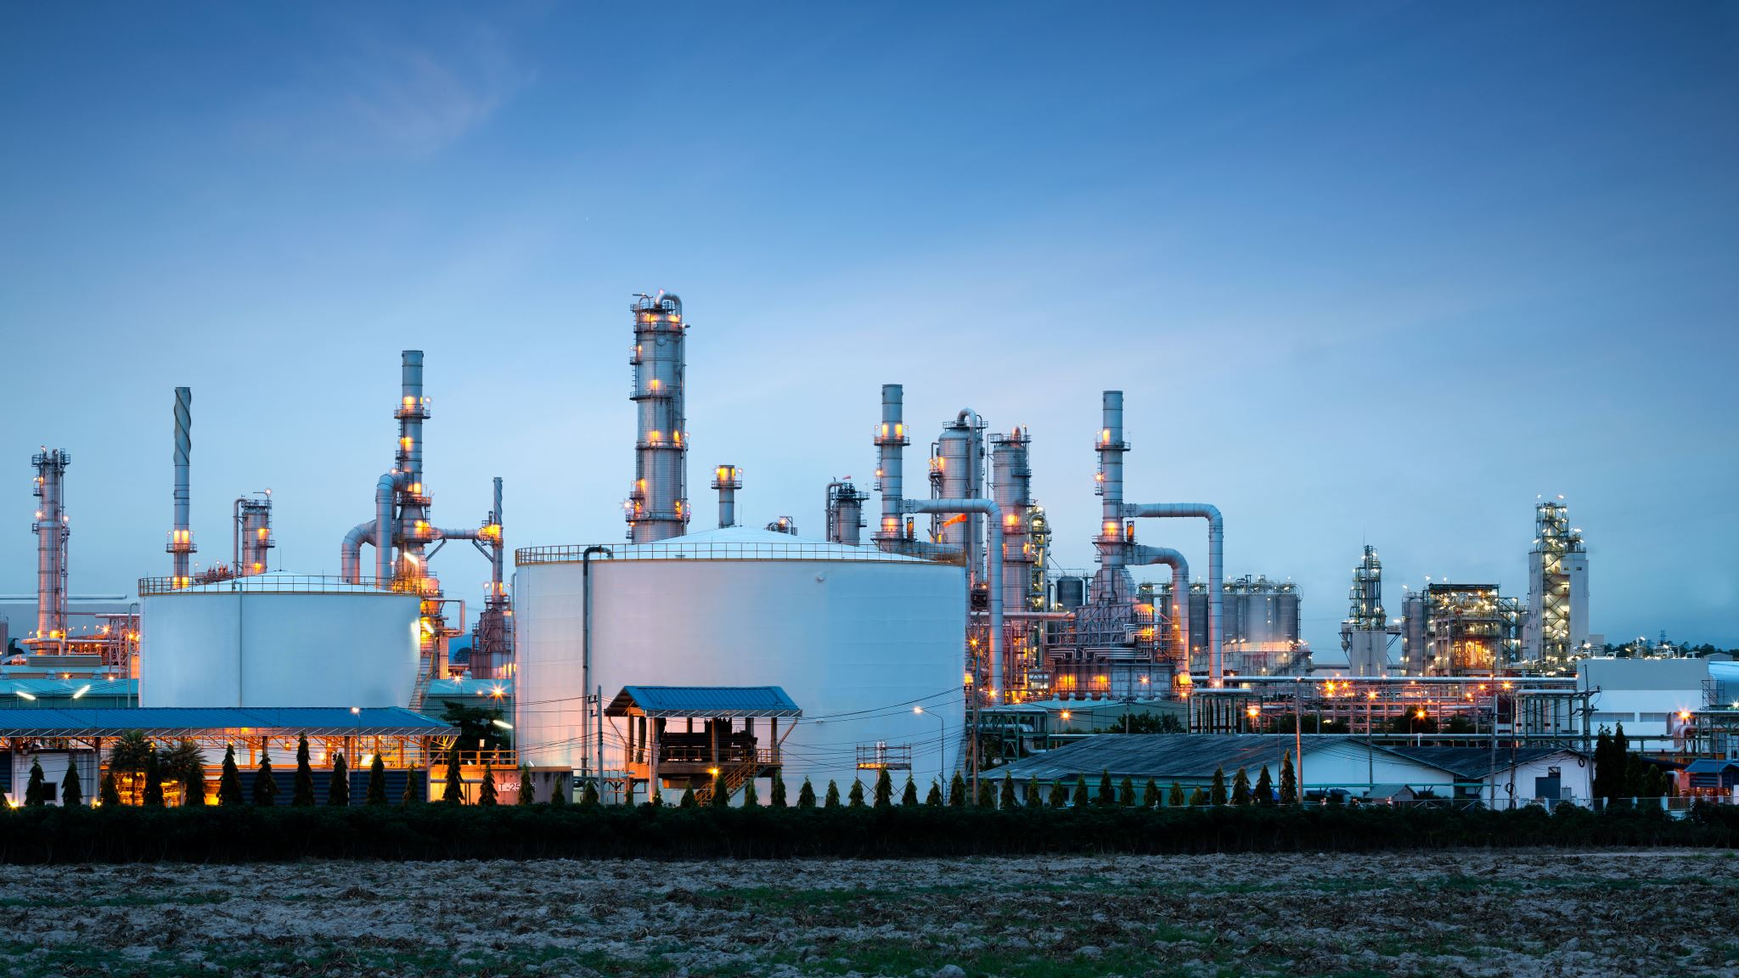

Key Insights
Oil & Flaring: Higher oil production leads to more flaring, especially where gas infrastructure is limited.
Energy Loss: Flaring wastes large amounts of usable energy that could be recovered.
Air Quality: PM levels are driven by multiple sources, not flaring alone.
Climate Impact: Reducing flaring and methane slip cuts greenhouse gas emissions quickly.
Health Impact: Communities near flaring sites face higher respiratory and cardiovascular risks.

Slide 11




Policy Recommendations & Impact Reduction
Based on our findings, we propose targeted policy recommendations to significantly reduce gas flaring and its associated negative impacts.
Recover the Gas: Expand gas capture, reinjection, mini-LNG, and gas-to-power solutions to reduce flaring.
Upgrade Infrastructure: Invest in pipelines, processing units, and storage to eliminate routine flaring.
Strengthen Regulations: Set clear national targets for flare reduction, methane capture, and DE improvement.
Improve Air-Quality Monitoring: Deploy real-time PM and methane monitoring, especially near production sites.
Protect Local Communities: Prioritize health assessments and mitigation measures for populations near flaring areas.

Slide 12


Conclusion & Future Work
Our project provides a robust framework for understanding and mitigating the impacts of flare gas. Continued effort is vital for a sustainable future.
1
Summary of Findings
Gas flaring presents significant environmental, energy, and health challenges, with discernible trends and affected populations.
2
Actionable Recommendations
Proposed policies focus on stricter regulations, technological adoption, transparent reporting, and community support.
3
Next Steps
Further research could explore the socio-economic impacts in greater detail and develop predictive models for flaring hotspots.

Slide 13
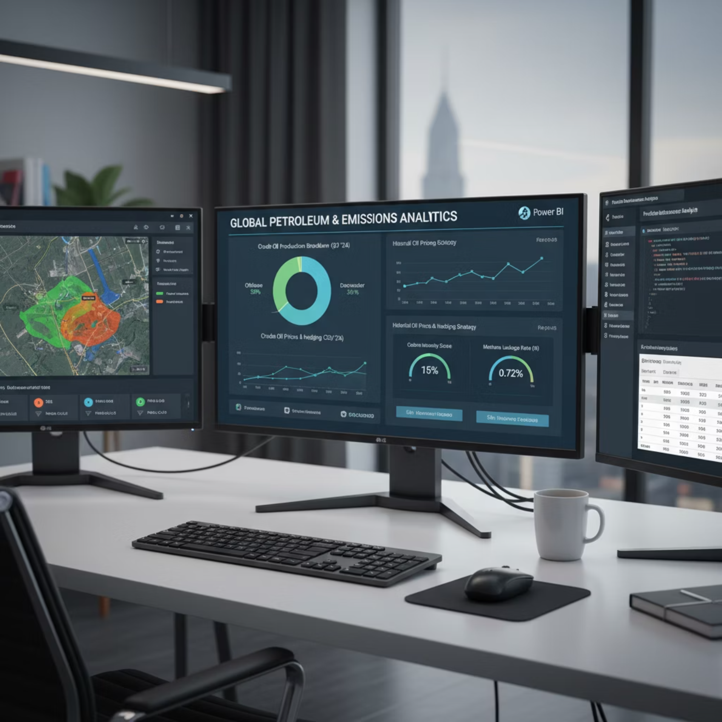


References & Acknowledgements
This project was made possible through dedicated data analysis and the utilisation of advanced tools.
Data Sources
World Bank Global Gas Flaring Reduction Partnership (GGFR) data
State Global of Air data for air pollutant concentrations
Public health registries and environmental agencies
EDGAR – Emissions Database for Global Atmospheric Research
OPEC Digital Publications – Annual Statistical bulletin
Tools Used
Power BI: For data cleaning, preprocessing, analysis, and dashboard creation.

Slide 14
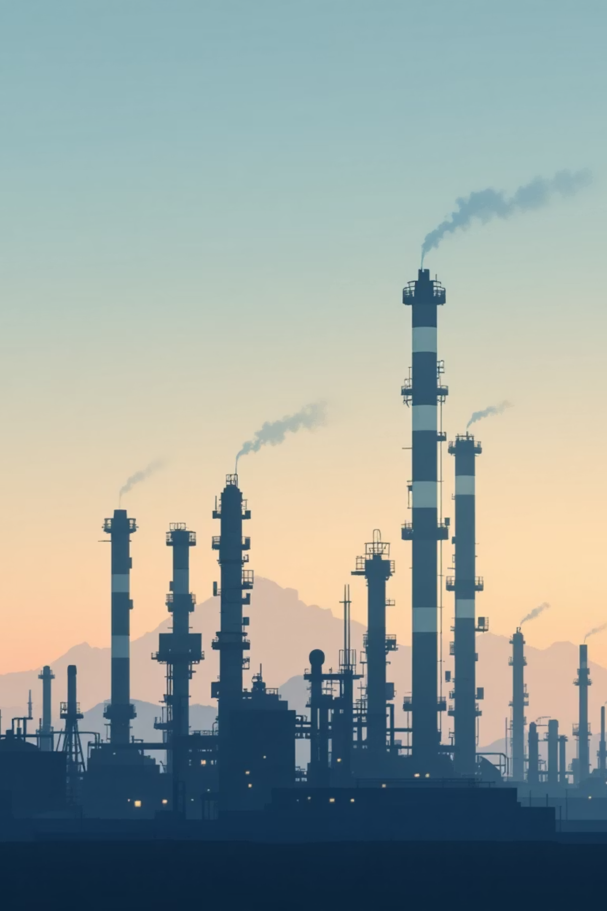
Thank You
Thank you for your attention. We are committed to fostering a cleaner, healthier planet through data-driven insights.
Project Team
Amira Hassan Abdalsalam “oil production Dashboard” Shahinaz Bashir Abdallah “Air Quality Dashboard” Nehad Hesham Fathy “Climate Change Dashboard” Esraa Gamal Awed “Health Impact Dashboard” “Each team member worked end-to-end on the dashboard: data cleaning, modeling, DAX,
and visualization.”

